Slide 1
PERFORMANCE ANALYSIS OF UNDERWATER WIRELESS OPTICAL COMMUNICATION SYSTEM(UWOC)
ECE4099 - Co-Op / Capstone Project - Project
GUIDE:
Prof. Dr. SANGEETHA A
PROJECT MEMEBERS:
SAPARI A V(16BEC0599)
BALACHANDIRAN KAILASH(16BEC0709)
MANISH PAULSON(16BEC0712)

Slide 2
Motivation:
Around 75% of the earth is covered with water. It contains a large number of natural resources, and to explore these resources, the development of an effective underwater wireless communication system became very vital
In recent times Underwater optical wireless communication (UWOC) systems have been receiving a great deal of attention because of their advantages of higher data rates, lower latency, and security while comparing it to the traditional acoustic communications and RF communication systems[1].
However, the problem is that the transmitting length is relatively short compared to acoustic communication and RF communication systems. It is because the light beam in the channel suffers from absorption, scattering, and the turbulence fading of the water channel.
Despite these drawbacks, UWOC is still one of the promising technologies. Thus, exploring this UWOC to its full potential has become essential for our effective communication[1].

Slide 3
Objective:
Underwater channel Modelling
The primary objective of this project is to simulate an impulse function for an underwater wireless channel for different water types with primary factors affecting the channel are scattering and absorption.
2.Performance analysis:
From the simulated impulse function, we transmit signals with different kinds of mapping schemes, namely OFDM with 4-QAM, 16-QAM, and OFDM with 4-PSK, 16-PSK, and record Bit error rate (BER) of these different signals and analyse and compare their performance based on its BER and transmitting length.
3. Reducing the Bit error rate:
Moreover, to achieve the maximum distance a signal can be transmitted and to reduce the bit error rate, we deploy different error correction techniques such as LDPC and BCH encoding. Then we compare their performance with the signals that haven’t been encoded.

Slide 4
CHANNEL MODELLING

Slide 5
Channel modelling:
The underwater environment is a very harsh and dynamically changing communication channel. The optical properties seawater is strongly affected by absorption, scattering, and turbulence[1-7].
Factors that affect Underwater optical channel:
Absorption is the process in which the photon energy is lost due to the transfer of power during the interaction with water molecules, dissolved organic matters, and particles.
The scattering, the photons are scattered away from the original path after interacting with particulate matter in the water. Scattering may cause temporal beam spreading, which results in inter-symbol interference (ISI) and degrades system BER performance.
The energy loss caused by these two effects can be expressed by the absorption coefficient a(λ)and the scattering coefficient b(λ), respectively.
The attenuation coefficient c(λ)=a(λ)+b(λ)is also defined to describe the overall energy loss in the channel.
The optical beam will also suffer from turbulence-induced fading
Experiments have shown that turbulence can be separated from particle scattering and absorption . Therefore, we consider only attenuation of signal to reduce the complexity of the analysis[1].

Slide 6
Existing channel model:
ADDITIVE WHITE GAUSSIAN NOISE (AWGN) :
Most of the channel models use Additive white Gaussian noise (AWGN) as an underwater channel. The results simulated are based on observing BER while increasing noise in the channel. The results generated from this channel does not account for varying lengths of channel, absorption or scattering coefficients. Thus this method cannot be ideal for performance analyse of the of the channel[7].
DOUBLE GAMMA FUNCTION(DGF):
This is the most commonly used Impulse function for under water wireless channel. However this model is Inspired by Mooradian’s work on modelling the impulse response in clouds. The channel properties of seawater differ from clouds to some extent. Therefore, we can observe a considerable degree of difference between the DGF model and the simulation results[8-13].

Slide 7
Existing channel model:
DGFs were first adopted to model the impulse response in cloud. Inspired by the dispersive nature of both cloud and underwater channels, Tang applied DGFs to model the impulse response in UOWC links[1].
3.Weighted double gamma functions(WDGF) :
This WDGF is a function inspired by the DGF. In order to generalize these functions for underwater channel, Dong added two parameters to the DGFs and proposed the weighted double gamma functions (WDGF)
where α and β are the two newly added parameters to be determined[1].
h(t)= C₁te^{-c2t}+C₃te^{-c4t} | (1)
h(t)=C₁t^{α} e^{-c2t}+c₃t^{β} e^{-c4t} | (2)

Slide 8
Need for a new channel model:
The Monte Carlo simulation shows us that the tail of the impulse function should be convex in WDGF Function. But WDGF is strictly concave function. Although a fit can be made to the experimental data , it will constantly underestimate the intensity of the tail because of this difference of convexity[1].
Motivated by the problem, A new function was proposed that can be written in the form of a Combination of Exponential And Arbitrary Power Function (CEAPF) as below:
Where ∆L = v∆t, C'₁ = (bv)β-αC₁, C'₂ = bvC₁, a and b are absorption and scattering coefficients respectively, we can compare different water types with the same scattering length[1].
h(t) = $C_{1}^{′}.\frac{{(b∆L)}^{α}}{{(b∆L+C_{2}^{′})}^{β}}$.$e^{−\frac{a}{b}.b∆L}$.$e^{−\frac{a}{b}.bL}$ | (3)

Slide 9
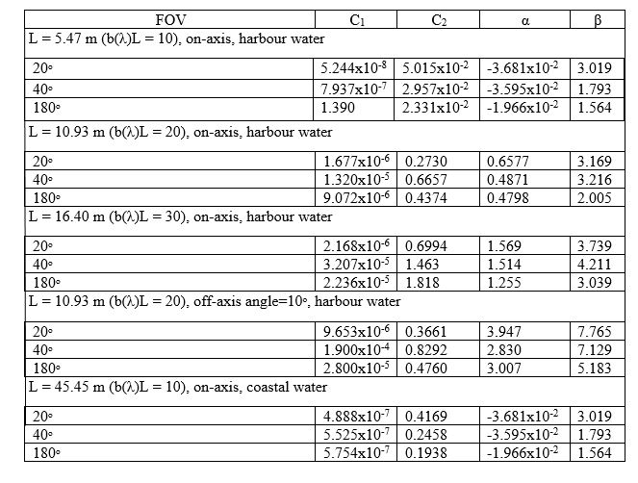
Constants of CEAPF:
v = 2.237 × 10⁸ m/s, Absorption coefficient(a) =0.366 m⁻¹,Scattering coefficients(b)=1.829 m⁻¹ (Harbour water)
Absorption coefficient(a) =0.179m⁻¹ ,Scattering coefficients(b )=0.220m⁻¹ (Coastal water)
Table.1 below shows the parameter of CEAPF in Different UOWC Channels[1]

Slide 10
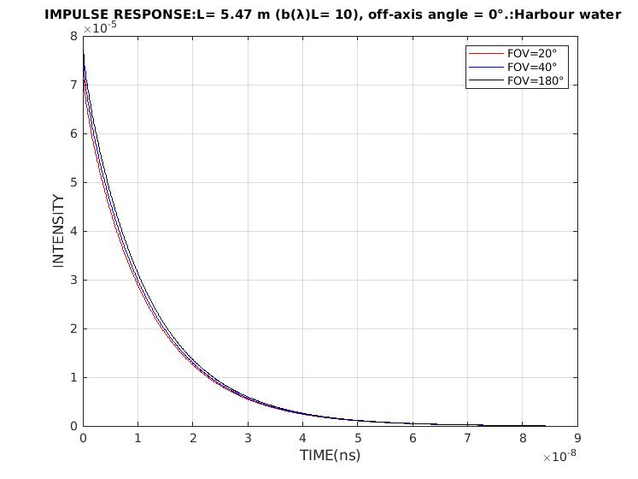
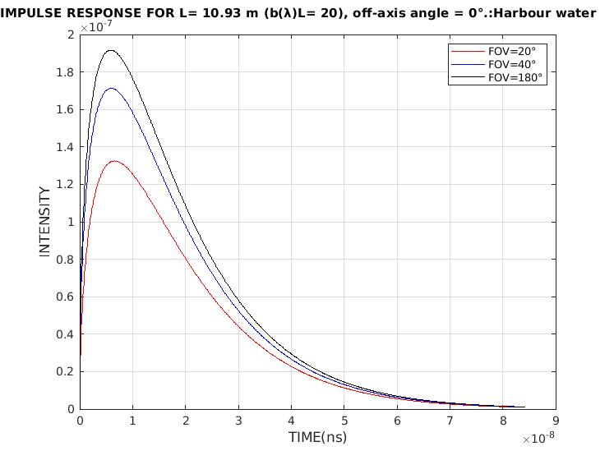
Simulated Results for channel Impulse function combination of exponential and arbitrary power function(CEAPF)
GRAPH 1
GRAPH 2

Slide 11
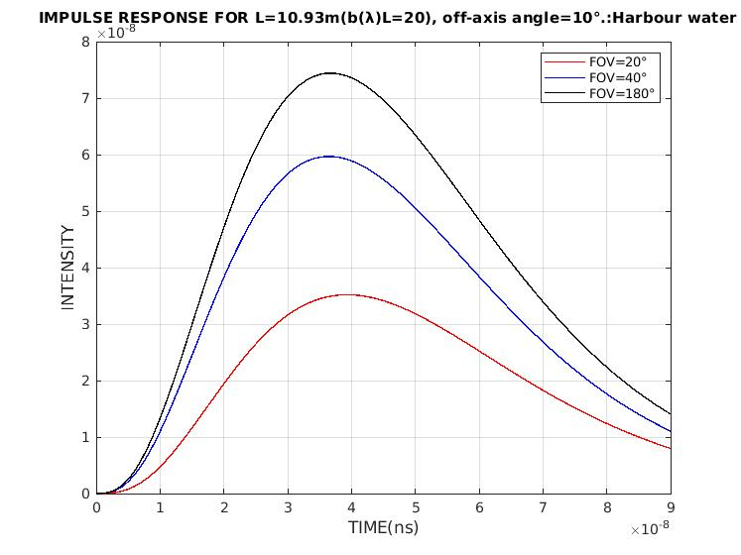
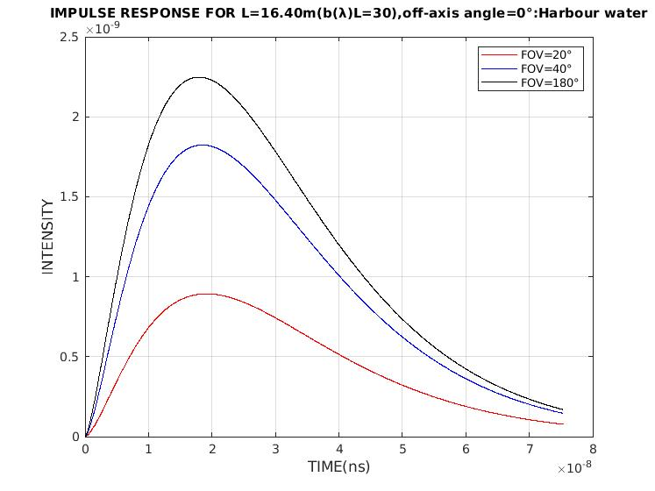
Simulated Results for channel Impulse function combination of exponential and arbitrary power function(CEAPF)
GRAPH 3
GRAPH 4

Slide 12
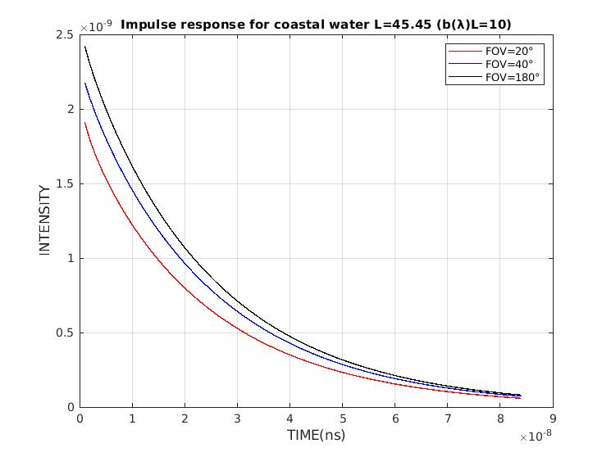
Simulated Results for channel Impulse function combination of exponential and arbitrary power function(CEAPF)
GRAPH 5

Slide 13
PERFORMANCE ANALYSIS:

Slide 14
GENERAL BLOCK DIAGRAM:
Data generation
Encoding data(LDPC,BCH)
QAM/PSK MAPPING
OFDM MODULATION
UNDERWATER WIRELESS CHANNEL
RECEIVED BITS
DECODING THE DATA
QAM/PSK DEMAPPING
OFDM DEMODULATION

Slide 15
Constraints, Alternatives and Tradeoffs
The primary constraint of this project is that even though the real-time water channel impulse function is affected by absorption, scattering, turbulence-induced fading caused by temperature and salinity of water, as well as randomly distributed air bubbles in the water. However, to reduce the complexity of the analysis, we have only taken the effects of absorption and scattering, the properties of which can be described by the inherent optical properties (IOPs) of the water.
This project's channel impulse function is based on our base paper [1], which offers only two different types of channels, i.e., harbour water and coastal water. It is because this CEAPF channel model is newly proposed. Moreover, we do not have enough data to simulate channel for other water types, other than the types mentioned above. Thus, our project is limited to only these two water types.
In this underwater wireless channel, we have experimented with 4-QAM, 16-QAM, 4- PSK, 16-PSK. We were limited to modulation order of 16 because, when we increase the modulation order, the data rate increases; thus, the signal attenuates massively even for short link lengths.

Slide 16
Constraints, Alternatives and Trade-offs
we were not able to receive the total message signal transmitted above the modulation order of 16. So, it is evident that when we move to a higher modulation order, the Spectral efficiency of the system is affected severely.
When we see the BER vs Length output graph of the PSK modulation, we can observe that the plot suddenly stops after reaching its peak, unlike QAM modulation, where the plot continues even after reaching the peak. This behaviour is only seen in PSK because, after a certain length, only half of the transmitted signal is received. Since this graph is a computer-generated, we cannot decode the message when only half of the signal is received. So, after a certain length, we stop simulation manually to avoid the error.

Slide 17
RESULTS

Slide 18
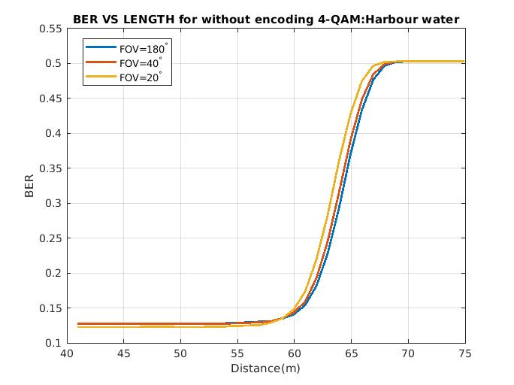
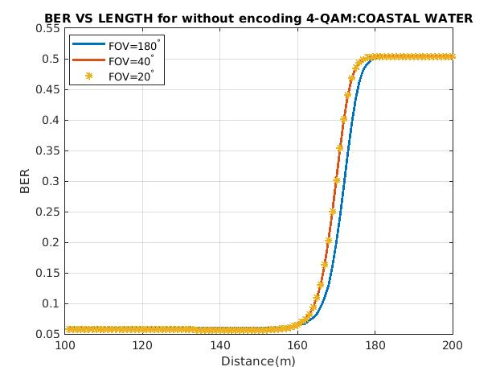
4-QAM WITHOUT ENCODING
4-QAM(BER=0.1343) MAX DIST=62m HARBOUR
4-QAM(BER=0.0601) MAX DIST= 161.9m COASTAL
Graph.6
Graph.7

Slide 19
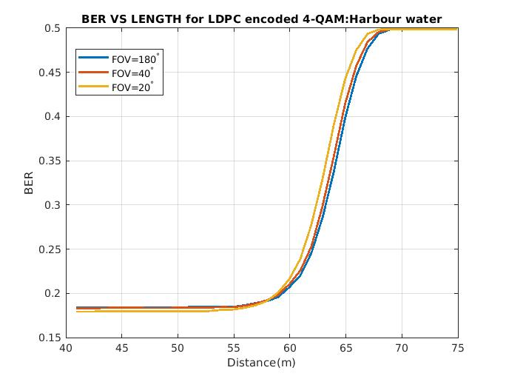
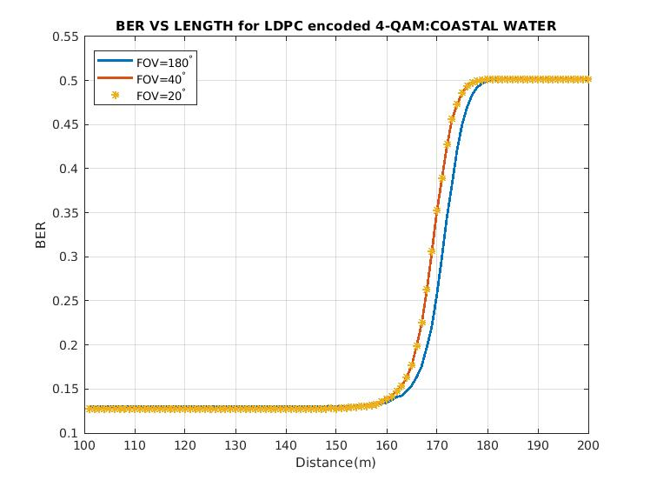
4-QAM LDPC-ENCODING
4-QAM(BER=0.1739) MAX DIST= 62m HARBOUR
4-QAM(BER=0.1260) MAX DIST= 161.9m COASTAL
Graph.8
Graph.9

Slide 20
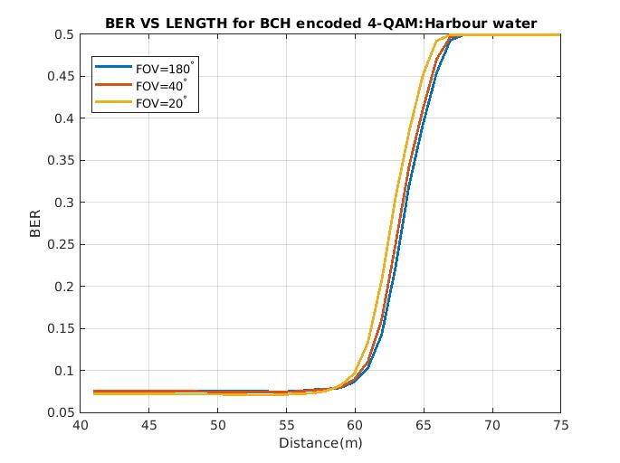
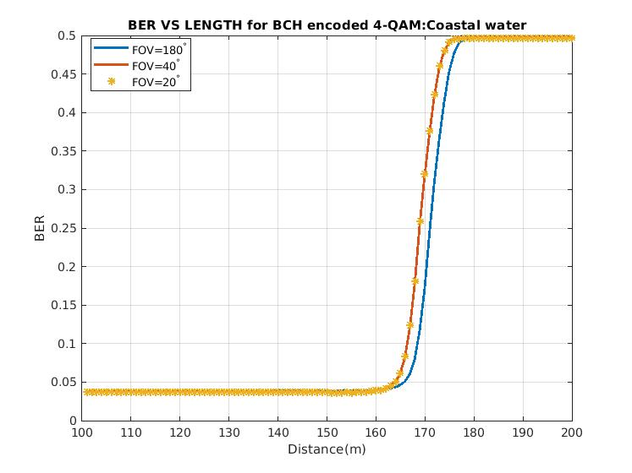
4 QAM BCH-ENCODING
4-QAM(BER=0.0717),MAX DIST= 62m HARBOUR
4-QAM(BER=0.0525) MAX DIST= 161.9m COASTAL
Graph.10
Graph.11

Slide 21
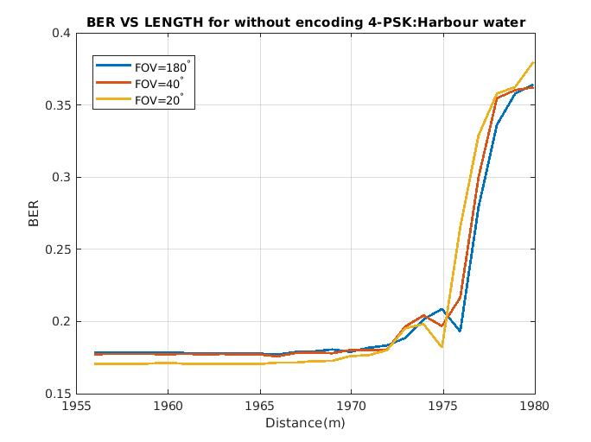
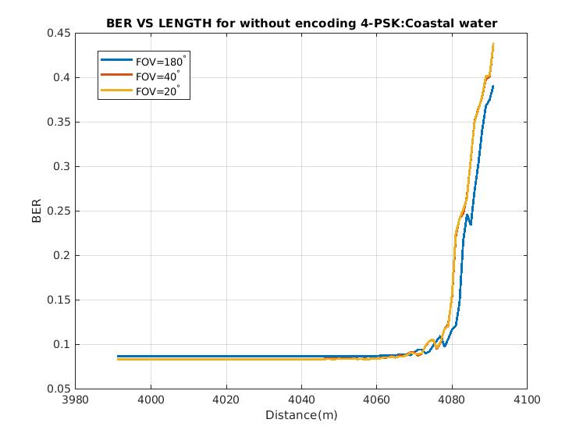
4-PSK WITHOUT ENCODING
4-PSK(BER=0.1725) MAX DIST= 1982m HARBOUR
4-PSK(BER=0.08451) MAX DIST= 4076m COASTAL
Graph.12
Graph.13

Slide 22
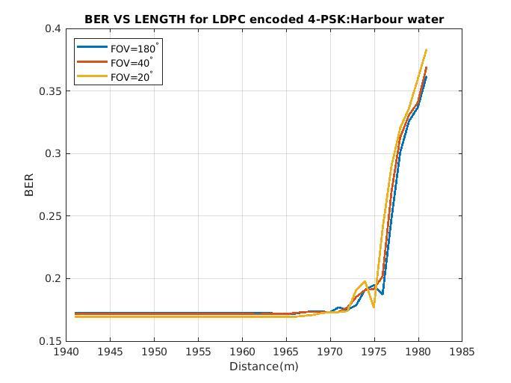
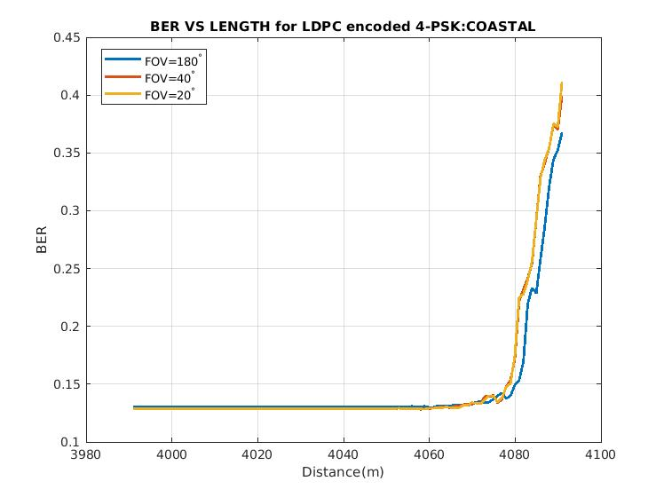
4-PSK LDPC-ENCODING
4-PSK(BER=0.1693) MAX DIST= 1982m HARBOUR
4-PSK(BER=0.1231) MAX DIST= 4076m COASTAL
Graph.14
Graph.15

Slide 23
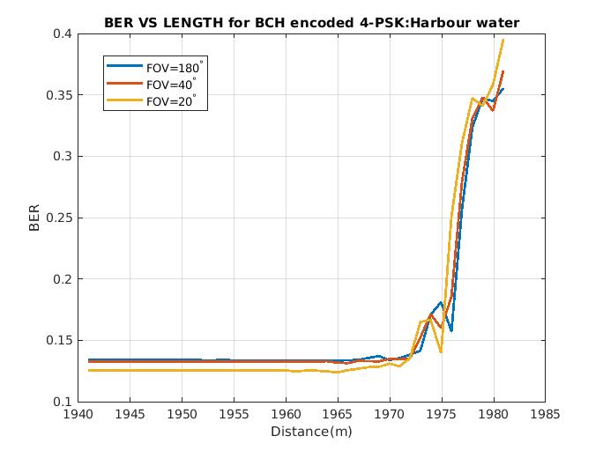
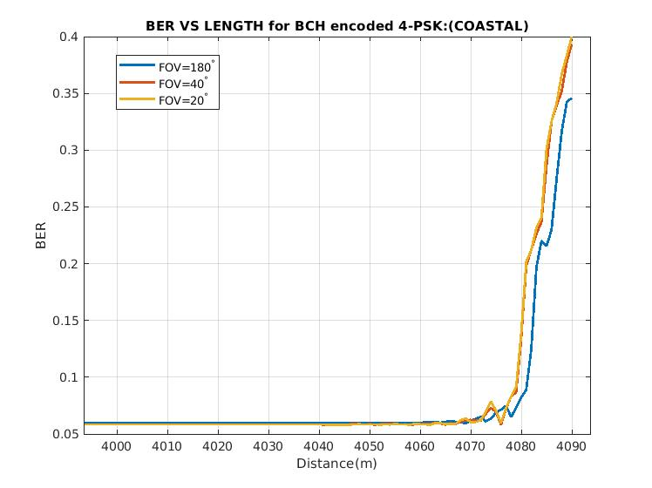
4-PSK BCH-ENCODING
4-PSK(BER=0.1238) MAX DIST= 1982m HARBOUR
4-PSK(BER=0.06170) MAX DIST= 4076m COASTAL
Graph.16
Graph.17

Slide 24
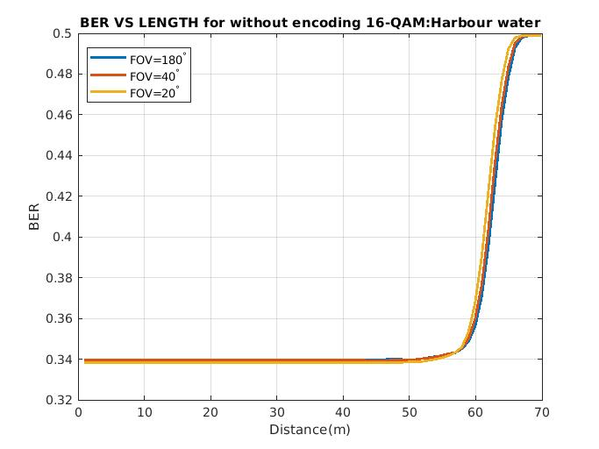
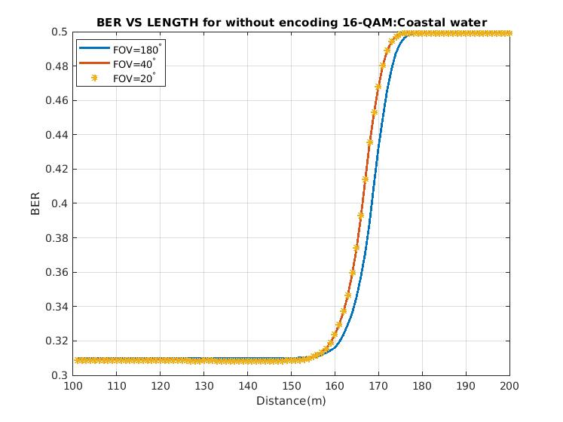
16-QAM WITHOUT ENCODING
16-QAM(BER=0.3378) MAX DIST= 62m HARBOUR
16-QAM(BER=0.3099) MAX DIST= 161.9m COASTAL
Graph.18
Graph.19

Slide 25
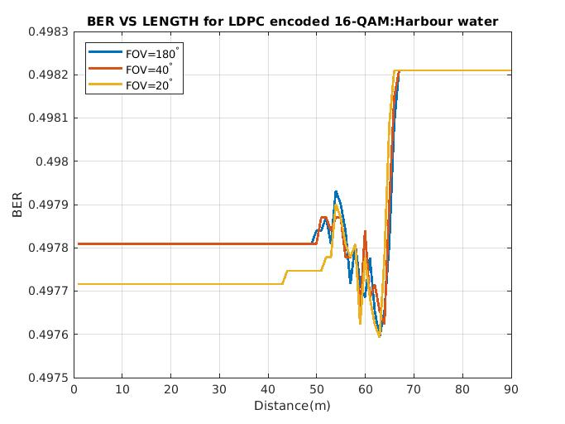
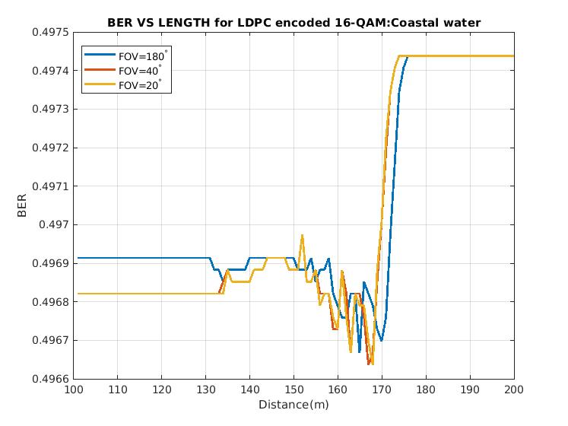
16-QAM LDPC ENCODING
16-QAM(BER=0.4919) MAX DIST=48m HARBOUR
16-QAM(BER=0.49858) MAX DIST= 161.9m COASTAL
Graph.20
Graph.21

Slide 26
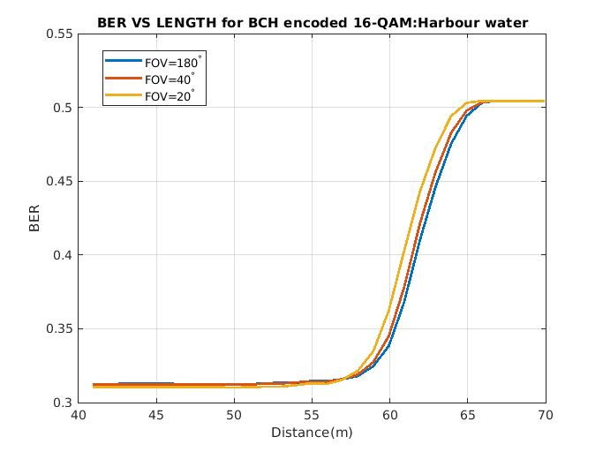
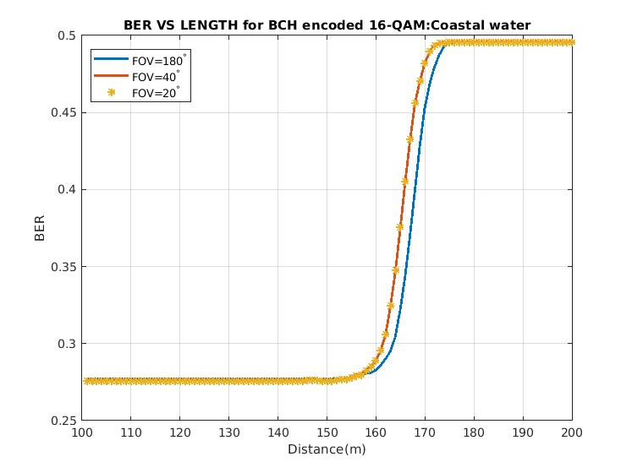
16-QAM BCH ENCODING
16-QAM(BER=0.307) MAX DIST= 62m HARBOUR
16-QAM(BER=0.2786) MAX DIST= 161.9m COASTAL
Graph.22
Graph.23

Slide 27
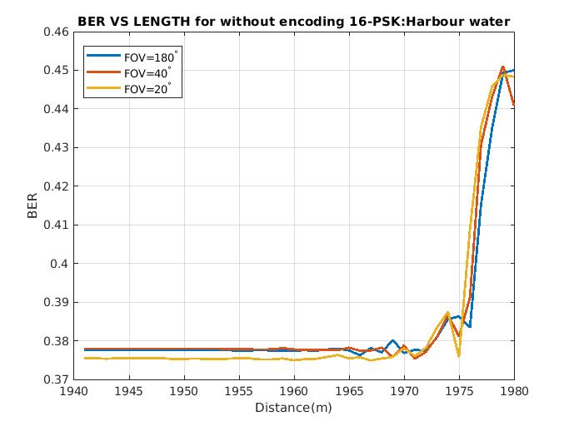
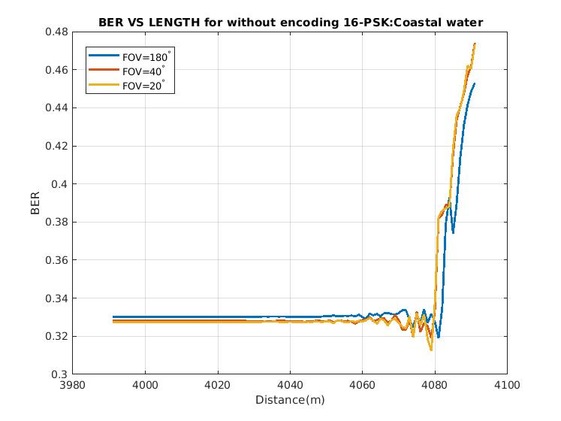
16-PSK WITHOUT ENCODING
16-PSK(BER=0.3753) MAX DIST=1982m HARBOUR
16-PSK(BER=0.2264) MAX DIST= 4081m COASTAL
Graph.24
Graph.25

Slide 28
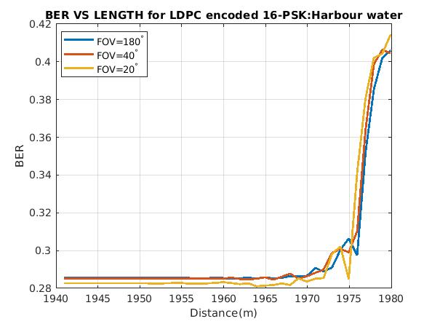
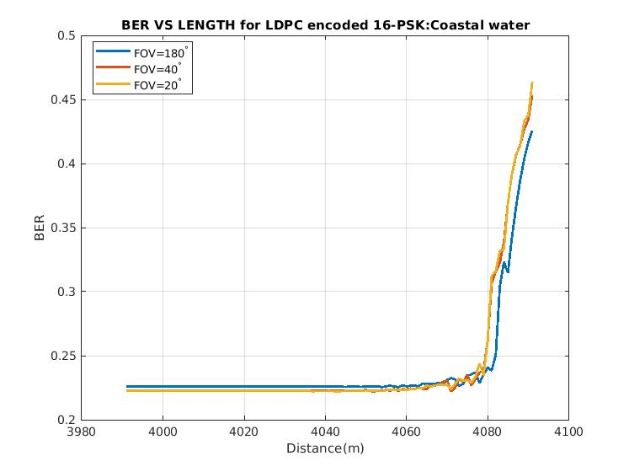
16-PSK LDPC ENCODING
16-PSK(BER=0.2786) MAX DIST= 1982m HARBOUR
16-PSK(BER=0.2264) MAX DIST= 4081m COASTAL
Graph.26
Graph.27

Slide 29
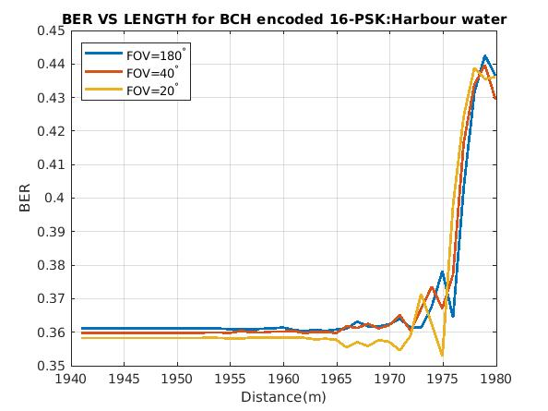
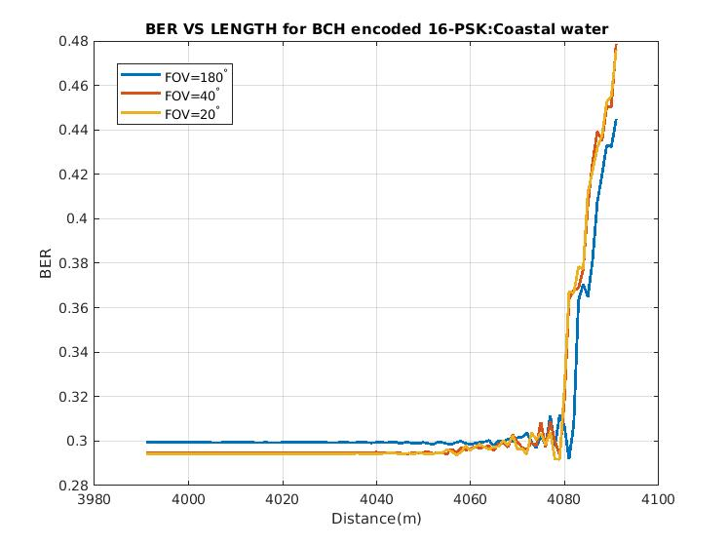
16-PSK BCH ENCODING
16-PSK(BER=0.3615) MAX DIST= 1982m HARBOUR
16-PSK(BER=0.3021) MAX DIST= 4081m COASTAL
Graph.28
Graph.29

Slide 30
OBSERVATION

Slide 31
Table.2
S.no | Modulation | Modulation order | Encoding | BER(HARBOUR) | BER(COASTAL) | Max.distance(m) HARBOUR | Max.distance (in m) (COASTAL)
1. | QAM-OFDM | 4 | BCH | 0.0717 | 0.0525 | 62 | 161.9
2. | QAM-OFDM | 4 | LDPC | 0.1739 | 0.126 | 62 | 161.9
3. | QAM-OFDM | 4 | NIL | 0.1343 | 0.0601 | 62 | 161.9
4. | PSK-OFDM | 4 | BCH | 0.1238 | 0.0617 | 1982 | 4076
5. | PSK-OFDM | 4 | LDPC | 0.1739 | 0.1231 | 1982 | 4076
6. | PSK-OFDM | 4 | NIL | 0.1725 | 0.08451 | 1982 | 4076
7. | QAM-OFDM | 16 | BCH | 0.307 | 0.2786 | 62 | 161.9
8. | QAM-OFDM | 16 | LDPC | 0.4919 | 0.49858 | 48 | 161.9
9. | QAM-OFDM | 16 | NIL | 0.3378 | 0.3099 | 62 | 161.9
10. | PSK-OFDM | 16 | BCH | 0.3615 | 0.3021 | 1982 | 4081
11. | PSK-OFDM | 16 | LDPC | 0.2786 | 0.2264 | 1982 | 4081
12. | PSK-OFDM | 16 | NIL | 0.3753 | 0.3235 | 1982 | 4081

Slide 32
RESULTS
Encoding the signal can offer lower BER. However, it is also true that not all encoding techniques provide lower BER for the transmitting signal.
When we look at the results table, we can see that BER is relatively low for BCH encoded signals while comparing it to the non-encoded message signal for their respective counterparts. Even though BER is relatively small, the encoding techniques we used do not provide longer transmitting length than the non-encoded signal. Thus, we can conclude that the Encoding the signal offers low BER, for it does not provide longer transmitting distance.
We can see that the BER is 22% lower for coastal water channels than the harbour water on an average. Furthermore, we can also evidently see that in the coastal channel, the message signal easily travels almost 61.4% and 51% more length than it travels in the harbour water for QAM and PSK signals, respectively.
We see that the BER is much higher for the modulation order of 16. That is because with increasing the modulation order, the data rate increases. Hence, we conclude that that BER increases with rising data rates.

Slide 33
RESULTS
One of the abnormal behaviours we observe in the table is that the LDPC encoded signal offers higher BER than the non-encode signals and BCH encoded signal. To justify this behaviour, we have found out that the LDPC code can be recommended as more effective if the signal to noise ratio (SNR) is more significant than 7dB [14] as we know that in coastal water channel that SNR is lower than 7dB. Hence the LDPC encoded signal offers lower BER.
When we compare the results of transmitting length provided by QAM modulation and PSK modulation, we can see that PSK modulation offers nearly 96% more transmitting length than QAM modulation in both Coastal and harbour water channels. Thus, we can conclude that PSK provides a more significant transmitting length than it is being supplied by QAM modulation.
One interesting behaviour noted in the BER vs Distance graph is that, the BER did not increase gradually with increasing distance as anyone would expect, but instead it stayed constant until the channel capacity reached and then exponentially reached its maximum value. This behaviour can also be seen in [15]

Slide 34
TIMELINE
Deadline | Tasks
2nd DEC - 22nd DEC | Working on the literature review of the project
23rd DEC - 14th JAN | Title discussion, Paper selection and Literary survey.
15th JAN – 31st JAN | Learning about the MATLAB and kept working on the literature review.
1st FEB – 20th FEB | Design of Channel Modelling
21st FEB – 4th MAR | Design of transmitter with QAM and PSK mapping with OFDM
5th MAR – 20th MAR | Passing QAM and PSK signals through the channel model and designing the receiver.
21st MAR – 4th APR | Generating and analyzing the output results and the bit error rate.
5th APR – 21st APR | Encoding the signal with LDPC and BCH error correction codes at the transmitter
22nd APR – MAY 4 | Transmitting the encoded signal through a model channel.
5th MAY – 11th MAY | Analyzing the results of 4QAM, 4-PSK, 16-QAM, 16-PSK OFDM with Encoding, and without Encoding.
12th MAY – MAY 27 | The final report thesis is completed with the required format. Manuscript for the paper and the poster of the project is designed.
Table.3

Slide 35
CONCLUSION
In this project, we have modelled an underwater channel response for Harbour and coastal water. Then we have analyzed the BER vs Length performance for these different Underwater wireless channel types. We have transmitted several signals with varying combinations of mapping schemes and error correction codes with different modulation orders
After all the simulations, it is quite clear that any signal transmitted in an underwater wireless channel suffers substantial attenuation due to parameters like absorption and scattering. This is a drawback. However, according to our findings in Table.2, the maximum transmitting distance, a signal can travel is varying from 48m-4076m.
The maximum distance we achieved in Underwater channel with the lowest BER is 4-PSK signal encoded with BCH error correction code is 4076m at FOV=180° in a coastal water channel.

Slide 36
Conclusion:
This distance we achieved can support various applications like Unmanned underwater vehicles, submarines, ships, and underwater sensors.
We can also deploy this to gather essential data such as real-time videos environmental and security data, which may be time sensitive[16].
However according to recent findings the maximum estimated distances of 144 m and 117 m with corresponding BERs of 1.89 × 10⁻³ and 5.31 × 10⁻⁴ at were acquired in UWOC system using on-off keying (OOK) modulation scheme, respectively[17], and also , Sonardyne has commercialized the BlueComm UWOC system which can operate over distances of up to 200 m [18], and 16-QAM OFDM signal travel 10.2 m with BER of 2.4×10-3 in a seawater channel[15], comparing to these data, the results we obtained is very reassuring that Underwater wireless channel has very high potential.

Slide 37
Future scope:
However, in this project, we have deployed only error correction codes like LDPC and BCH to control bit error rate.
We have not used equalization techniques like Volterra or least mean square methods to control error.
We further propose to incorporate different equalization techniques to enhance the performance of our system.
Using these methods the bit-error rate can be brought down by a significant number, and it also possible to increase the transmitting length.

Slide 38
REFERENCES:
[1] Yiming Li, Mark S. Leeson, and Xiaofeng Li, "Impulse response modeling for underwater optical wireless channels," (2018) Appl. Optical society of America 57, pp.4815-4823
[2] Huihui Zhang, Yuhan Dong. (2016). “General Stochastic Channel Model and Performance Evaluation for Underwater Wireless Optical Links” in IEEE Transactions on Wireless Communications ( Volume: 15 , Issue: 2 , Feb. 2016 ); Page(s): 1162 – 1173; INSPEC Accession Number: 15785893; DOI: 10.1109/TWC.2015.2485990
[3 ]Xueyi Geng ; Adam Zielinski. (2002). “An eigenpath underwater acoustic communication channel model”. Published in ‘Challenges of Our Changing Global Environment'. Conference Proceedings. OCEANS '95 MTS/IEEE, Publisher: IEEE, DOI: 10.1109/OCEANS.1995.528591; INSPEC Accession Number: 5225669, Conference Location: San Diego, California, USA.
[4] R. Galvin, R.E.W. Coats. (2002). “A stochastic underwater acoustic channel model”. Published in: OCEANS 96 MTS/IEEE Conference Proceedings. The Coastal Ocean - Prospects for the 21st Century, DOI: 10.1109/OCEANS.1996.572599, Publisher: IEEE, Conference Location: Fort Lauderdale, FL, USA.
[5] Albert F. Harris, Michele Zorzi. (2007). “Modeling the underwater acoustic channel in ns2”, Publication: ValueTools '07: Proceedings of the 2nd international conference on Performance evaluation methodologies and tools, October 2007, Article No.: 18, Pages 1–8.
[6] Hassan Makine Oubei, Emna Zedini, Rami T. ElAfandy, Abla Kammoun, Mohamed Abdallah, Tien Khee Ng, Mounir Hamdi, Mohamed-Slim Alouini, and Boon S. Ooi. (2017). “Simple statistical channel model for weak temperature-induced turbulence in underwater wireless optical communication systems”. Vol. 42, Issue 13, pp. 2455-2458. Publisher: Optical Society of America. 62
[7 ] M. A. Kishk and A. M. Alaa, "On the capacity of the underwater acoustic channel with dominant noise sources," 2014 IEEE 2nd International Symposium on Telecommunication Technologies (ISTT), Langkawi, 2014, pp. 183-187, doi: 10.1109/ISTT.2014.7238201.[8] C. T. Geldard, J. Thompson, E. Leitgeb and W. O. Popoola, "Optical Wireless Underwater Channel Modelling in the Presence of Turbulence," 2018 IEEE British and Irish Conference on Optics and Photonics (BICOP), London, United Kingdom, 2018, pp. 1-4, doi: 10.1109/BICOP.2018.8658289.
[9] S. Tang, Y. Dong and X. Zhang, "Impulse Response Modeling for Underwater Wireless Optical Communication Links," in IEEE Transactions on Communications, vol. 62, no. 1, pp. 226-234, January 2014, doi: 10.1109/TCOMM.2013.120713.130199.

Slide 39
REFERENCES:
[10] F. Dong, L. Xu, D. Jiang, and T. Zhang, "Monte-Carlo-Based Impulse Response Modeling for Underwater Wireless Optical Communication," Progress In Electromagnetics Research M, Vol. 54, 137-144, 2017doi:10.2528/PIERM16112403
[11]H. Zhang and Y. Dong, "Impulse response modeling for general underwater wireless optical MIMO links," in IEEE Communications Magazine, vol. 54, no. 2, pp. 56-61, February 2016, doi: 10.1109/MCOM.2016.7402261.
[12]Shijian Tang, Xuedan Zhang and Yuhan Dong, "On impulse response for underwater wireless optical links," 2013 MTS/IEEE OCEANS - Bergen, Bergen, 2013, pp. 1-4, doi: 10.1109/OCEANS-Bergen.2013.6607980.
[13]Y. Dong, H. Zhang and X. Zhang, "On impulse response modeling for underwater wireless optical MIMO links," 2014 IEEE/CIC International Conference on Communications in China (ICCC), Shanghai, 2014, pp. 151-155, doi: 10.1109/ICCChina.2014.7008262.
[14]Uryvsky, L.O. and Osypchuk, S.O., (2014). “Comparative analysis of LDPC and BCH codes errorcorrecting capabilities.”Published in: Information and telecommunication sciences (pp. 5-9)
[15]Wu TC, Chi YC, Wang HY, Tsai CT, Lin GR. Blue laser diode enables underwater communication at 12.4 Gbps. Sci. Rep. 2017;7:40480. doi: 10.1038/srep40480
[16]S. Jaruwatanadilok, "Underwater Wireless Optical Communication Channel Modeling and Performance Evaluation using Vector Radiative Transfer Theory," in IEEE Journal on Selected Areas in Communications, vol. 26, no. 9, pp. 1620-1627, December 2008, DOI: 10.1109/JSAC.2008.081202.
[17]H. Chen et al., "Toward Long-Distance Underwater Wireless Optical Communication Based on A HighSensitivity Single Photon Avalanche Diode," in IEEE Photonics Journal, vol. 12, no. 3, pp. 1-10, June 2020, Art no. 7902510, doi: 10.1109/JPHOT.2020.2985205.
[18]M. Khalighi, C. Gabriel, T. Hamza, S. Bourennane, P. Léon, and V. Rigaud, "Underwater wireless optical communication; recent advances and remaining challenges," 2014 16th International Conference on Transparent Optical Networks (ICTON), Graz, 2014, pp. 1-4, DOI: 10.1109/ICTON.2014.6876673.

Slide 40
THANK YOU

